Slide 1
Core Data Services (CDS)
May 19th, 2017

Slide 2
Meet The Speaker
Jonathan Andre
Lead Developer IT Partners

Slide 3
Our Agenda
About CDS / How to Create
Basic ABAP CDS View
Other Features ABAP CDS
HANA CDS and Native SQL

Slide 4
What is CDS?
Core Data Services, or CDS, is a “semantically rich” Data Definition Language (or DDL) created by SAP. It provides an easy to understand and reusable tool that ABAP developers can utilize to execute the “code pushdown” paradigm.
CDS comes in different flavors , a HANA version and an ABAP version:
HANA CDS - The lesser used option for ABAP coders is HANA CDS, the database language that can be used to create tables, views, and structures on the HANA database itself. Views created in HANA can be consumed from the Netweaver AS using Native SQL.
ABAP CDS – This is the CDS flavor that will almost be exclusively used in most SAP business software systems. ABAP CDS is usually the best choice when designing and creating database views that will need to access the HANA database.

Slide 5
What is CDS?
ABAP CDS, made available with SAP Netweaver 7.40 SP5, allows coders to achieve the “code-to-data” programming paradigm using a reusable resource that can be used across different programs and projects.
“Code-to-data”, also sometimes referred to as “code-pushdown” is the process of moving data intensive programming logic from the application later down to the database layer.
CDS achieves these primarily through the use of “Views”, however the views in the context of CDS go beyond those classical SE11 since much of the logic previously left to the programming level (i.e. ABAP program logic) can now be outsourced to the database level.
Although CDS performs well with the HANA database and takes advantage of many of its features, it is actually an OPEN DDL (data definition language) language. The term Open meaning that it will work with all traditional databases that can be used to run the latest versions of the SAP NetWeaver products.
An ABAP CDS file can ONLY be create within the Eclipse IDE (there is no transaction to do this from SAP GUI). CDS files are written in an augmented form of SQL Script

Slide 6
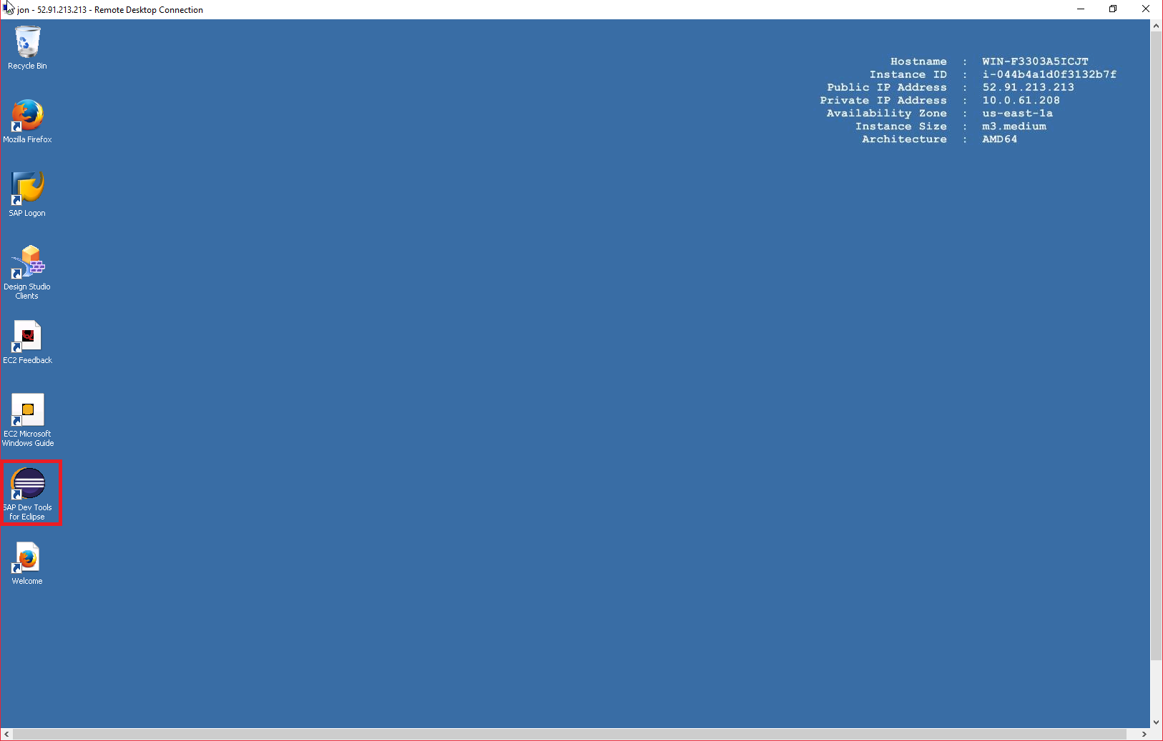
Creating First CDS View (Using AWS)

Slide 7
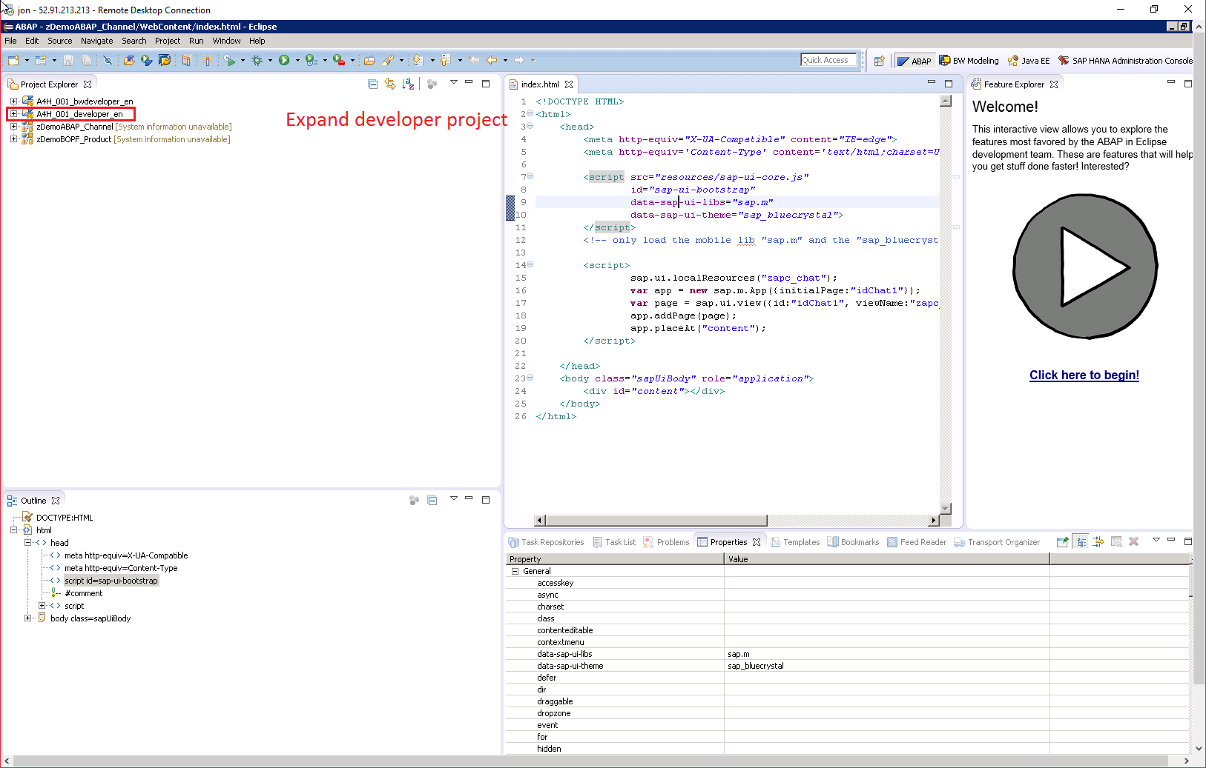
Creating First CDS View (Using AWS)

Slide 8
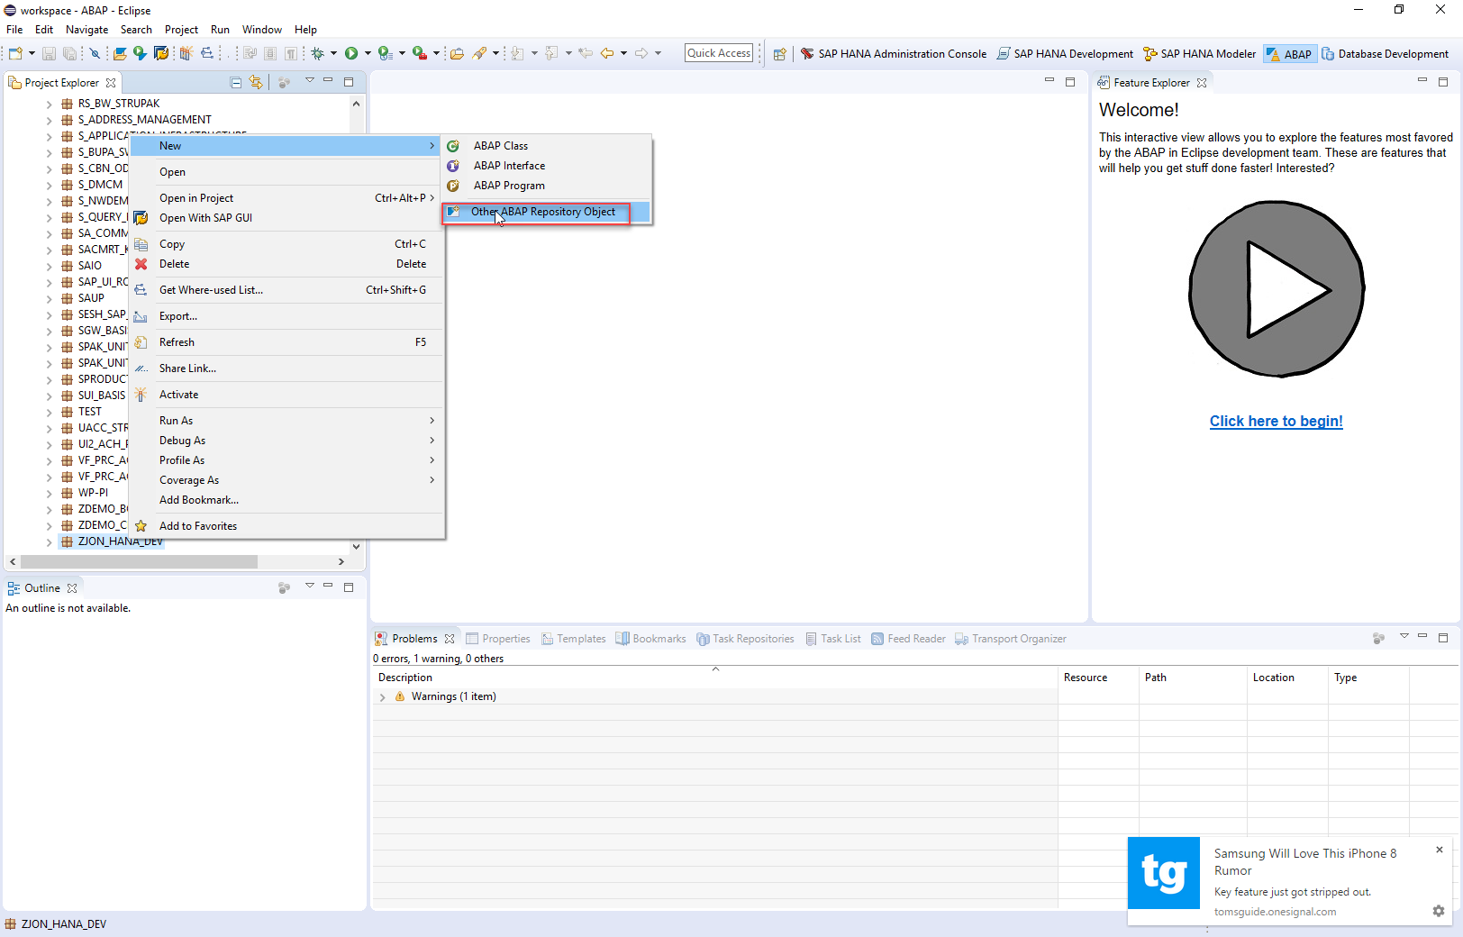
Creating First CDS View (Using AWS)

Slide 9
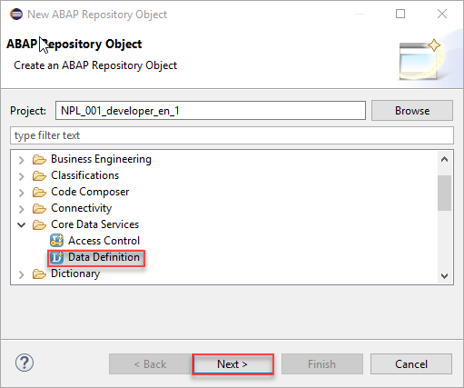
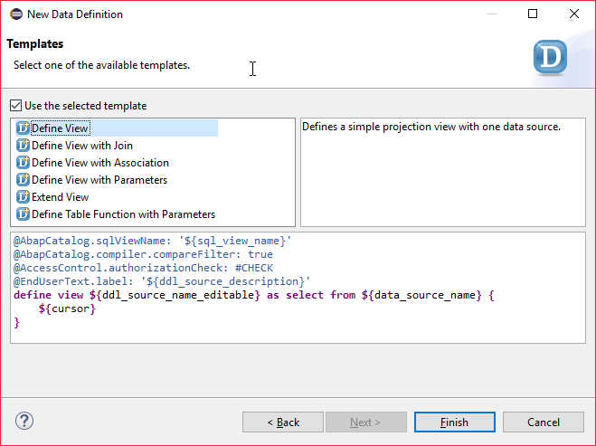
Creating First CDS View (Using AWS)

Slide 10
Creating First CDS View (Using AWS)
Opening Annotations – These declare high level data about the CDS view:
@AbapCatalog.sqlViewName is the only mandatory annotation for a non-extending CDS View source file.
@AbapControl.authorizationCheck specifies whether an authorization check should be performed for the current CDS view.

Slide 11
Creating First CDS View (Using AWS)
Datasource Declarations-
This section will come after the opening Annotations, but before the first curly bracket. Within this section, the developer specifies:
the type of view (define or extend view)
the CDS view name (in this case ZJON_CDS_VIEW_EXAMPLE),
the source table or view (SNWD_SO)
Any parameters (more on this later)
Any joins/associations (more on this later)

Slide 12
Creating First CDS View (Using AWS)
Field Declarations and Specifications
After the first curly bracket comes the desired fields from the table, as well as any fields that are to be computed.
This is the section that a developer will primarily utilize to take advantage of code-pushdown.
The CASE function allows a particular value to be returned based on the value of a table field.
We define the field returned as ‘payment_status’. To the calling program, there’s no difference between this generated field and a regular database field.

Slide 13
Creating First CDS View (Using AWS)
Select Conditions, Restrictions, and Grouping Declarations
The last section of the DDL source file is where you would add any selection restrictions (such as a where clause) in addition to any aggregation instructions (such as GROUP BY). We will be covering both of these options in later examples.

Slide 14
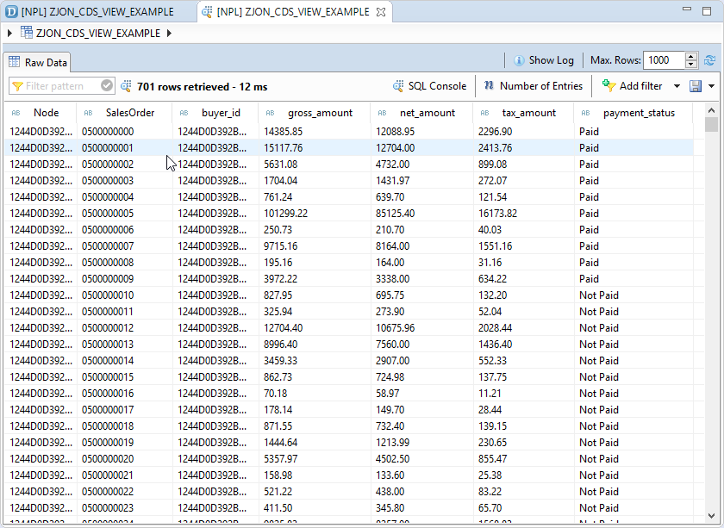
Previewing a CDS View
CDS Views can be previewed right within the Eclipse editor. To do this, right-click on the created view, select “Open With” and then select “Data Preview” from the submenu. (Note that in other versions of the ABAP Development Tools, the “Data Preview” option may appear immediately in the menu when you right click.)
Notice that, along with the data we have selected from the snwd_so table, we also have the calculated field payment_status that was created using the CASE function.

Slide 15
What happens on the HANA DB?
When you create an ABAP CDS View, a corresponding view is created on the HANA DB matching the CDS view created on the ABAP side.
This view will have the SQL View name that you provided (after the @AbapCatalog.sqlViewName annotation) and will be generated automatically after you create the CDS view.
The corresponding HANA view does not require a separate transport to move between HANA DBs. Once the view is transported and executed on SAP NetWeaver, the HANA View will be generated automatically in the corresponding HANA DB.
You can view the create SQL view in Eclipse by using the SQL HANA Administrator Perspective (described on the next slide).

Slide 16
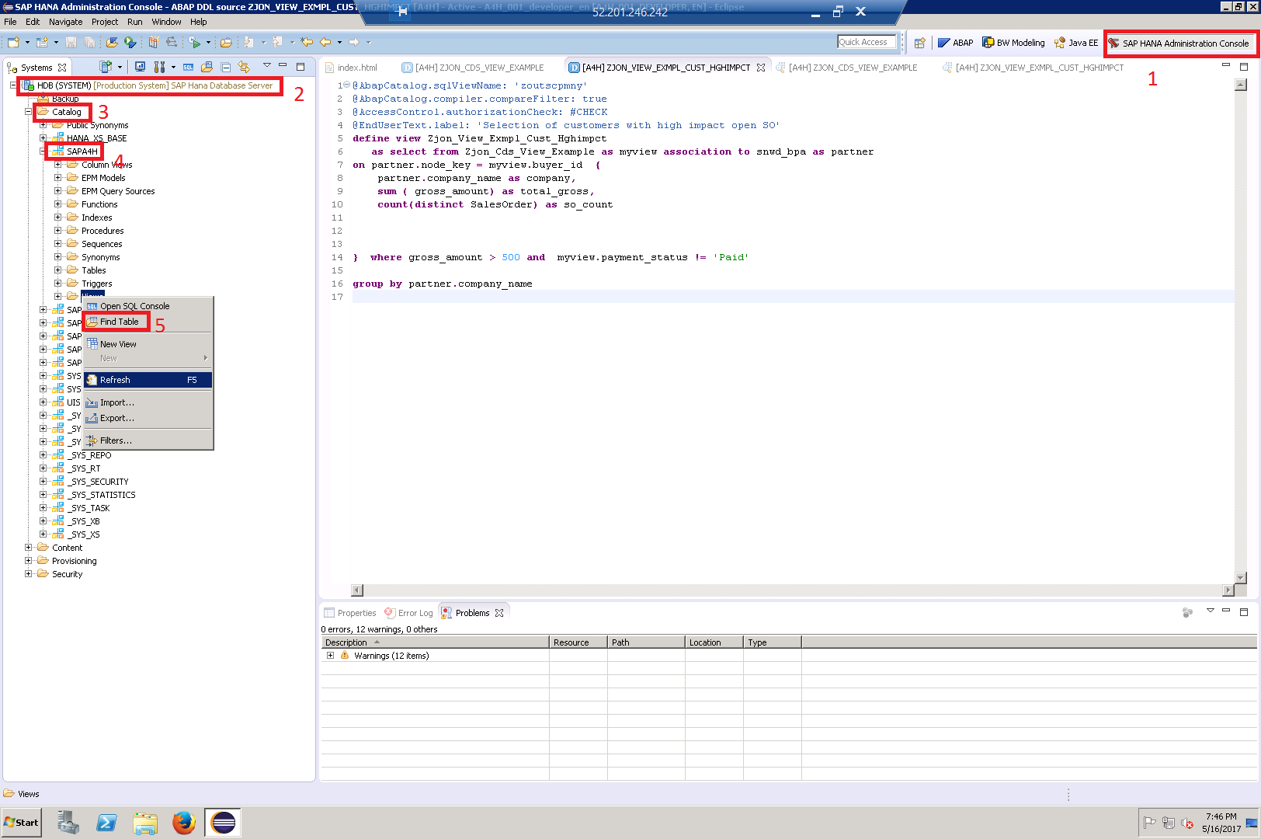
What happens on the HANA DB?
1 – Open the SAP HANA Administrator Console
2 – Log into the HDB system (password should be the same one for all usernames/windows login.
3 – Open the Catalog folder
4 – Navigate to the SAPA4H schema (which holds all tables/views for SAP NetWeaver)
5 – Click find table and type the sqlViewName you used for your first view (or any other CDS view you’ve created).
NOTE: Theres no requirement that his SQL View name be the same as your CDS view name! This SQL view name will be in the annotations section.

Slide 17
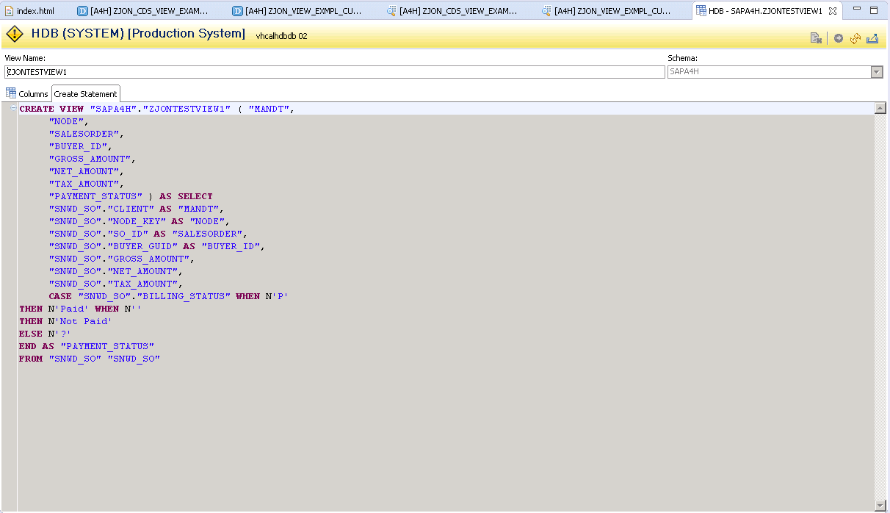
What happens on the HANA DB?
Double click on the SQL View name corresponding to your CDS view, and you should see a display with two tabs.
The first tab, Columns, displays the columns that are available with your CDS View.
The second tab shows the SQL statement for your view, which should look familiar. It should be nearly identical to the CDS View you coded on the NetWeaver side, with a few syntax adjustments to make it compatible with the HANA DB.

Slide 18
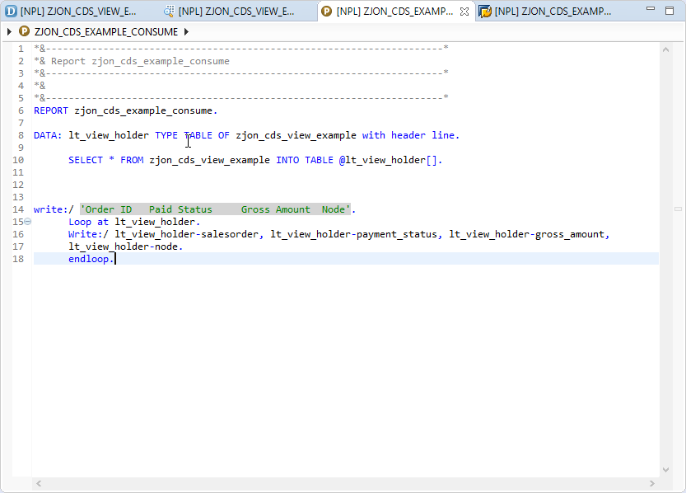
Using a CDS View in an ABAP Program
Using a CDS view simply requires using an Open SQL statement that selects from our CDS Entity (ZJON_CDS_VIEW_EXAMPLE). As an added benefit of ABAP CDS, a generated CDS Entity name can also be used in DATA declarations to create structures of a compatible TYPE:

Slide 19
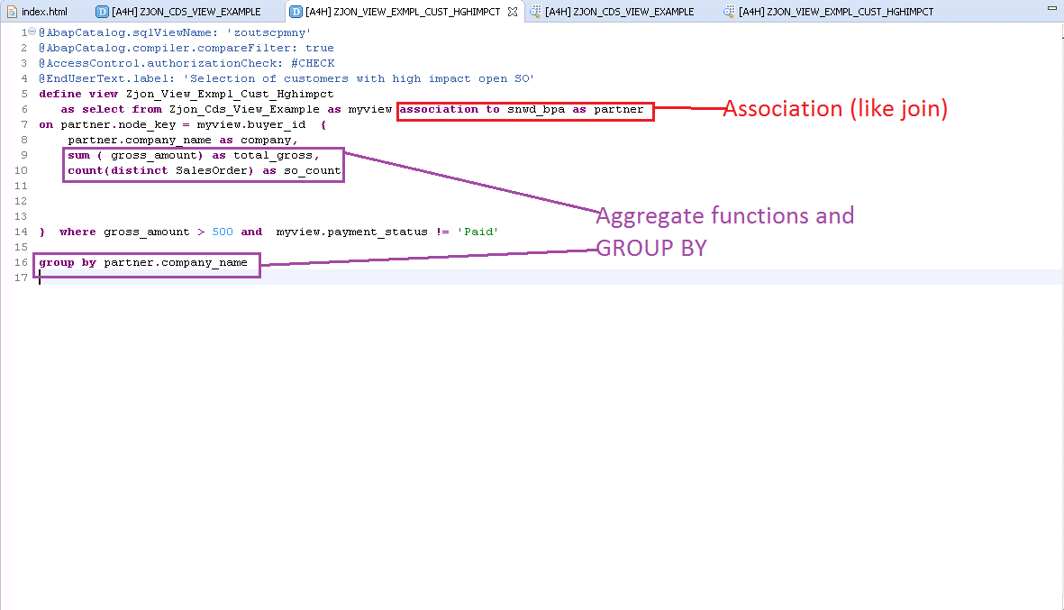
Associations
Associations are essentially reusable JOINS that relate two CDS Entities (tables or views) to each other. CDS Associations have the added benefit of being able to specify cardinality ([1..1], [0..1], [*], etc.). Many of the features of ASSOCIATIONS are available as JOINS, however ASSOCIATIONS are the preferred and more elegant option when merging two CDS entities.

Slide 20
Aggregate Functions
The aggregate functions available in CDS Views are the same ones that are available in the new Open SQL. Although they are readily available during a regular Open SQL Select, it is still an extremely useful tool to have in CDS Views. Using the CDS approach, developers can make certain summary data uniform across projects and systems without having to maintain entirely separate summary level tables. As you can see in the above example, any time you use these aggregate functions in the field declaration section, you are required to include the GROUP BY addition in the Selection Restriction and Condition section.
Removing the GROUP BY clause while having either of these functions remaining will raise a syntax error, which is logical since you cannot have summary level data item level records.

Slide 21
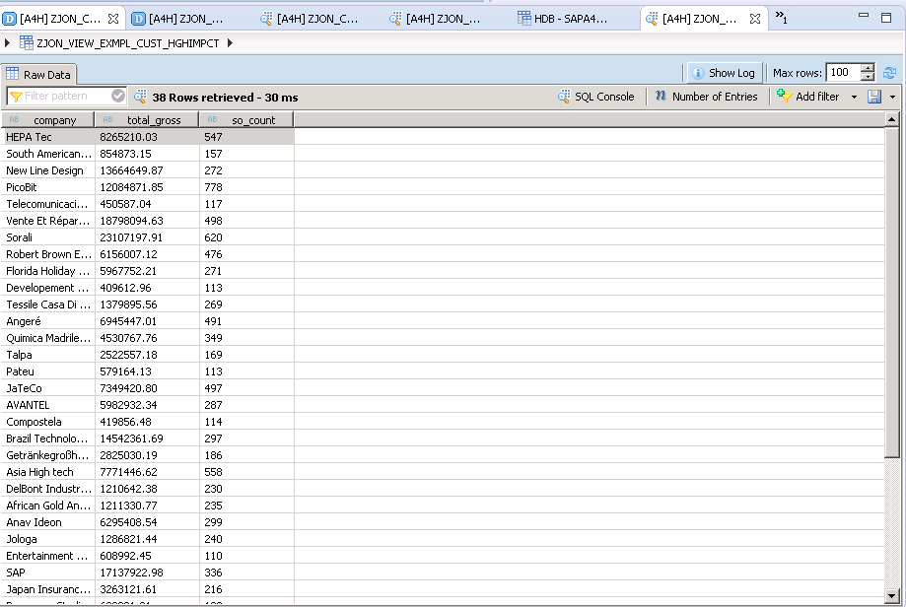
Aggregate Functions
The data preview shows that, instead of showing every single SO in the system, we are now showing the data summarized by company.
Using our CDS View with aggregate functions allows your us to view every company with unpaid sales orders with gross amounts over $500, who many of these sales orders they have, and the total gross amount of the sales orders.
Before HANA, a calculation like this would require selecting all this data into an internal table, looping through the documents one by one, and keeping track of totals.
Using CDS/HANA we can view this data much faster with all the work already completed for us!

Slide 22
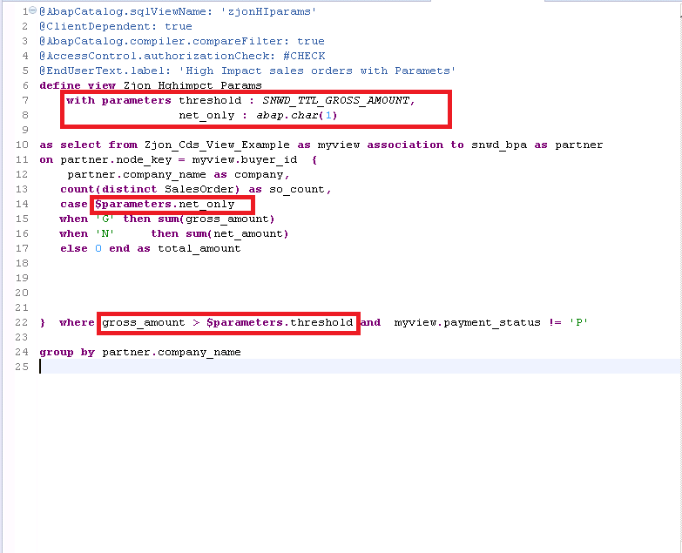
CDS View Parameters
CDS Views also allow for parameters to be used to help in building more dynamic views.
Parameter can be used to provide variable conditions to search conditions (similar to what one would achieve by using a WHERE clause.
Parameters can also be used to provide values for CASE statements, arithmetic calculations when calculating fields, and performing other alterations to functional operations that would not be possible with a classical SELECT statement.
All CDS Parameters are MANDATORY.

Slide 23
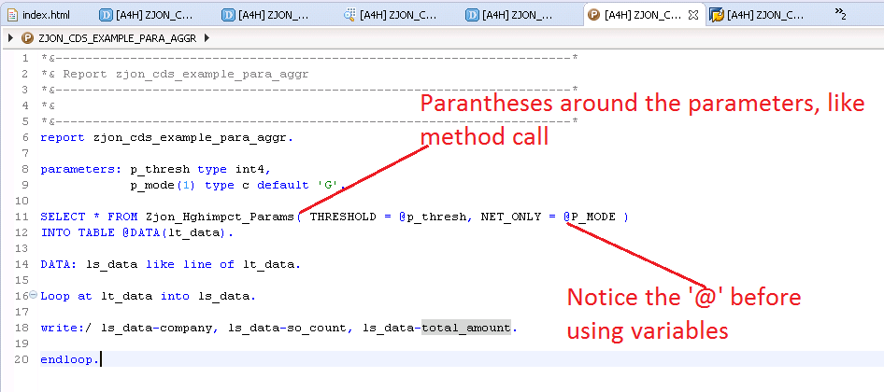
Using CDS Views with Parameters
To use the parameters in a SELECT statement, you would need to use parentheses after immediately following the CDS View name. This is similar to how you would pass parameters to a method call.
You can use variable values in the parameters by using the ‘@’ symbol before the variable name (which is common the new Open SQL syntax).
If you prefer to use hard coded strings or values instead, the ‘@’ is not required.

Slide 24
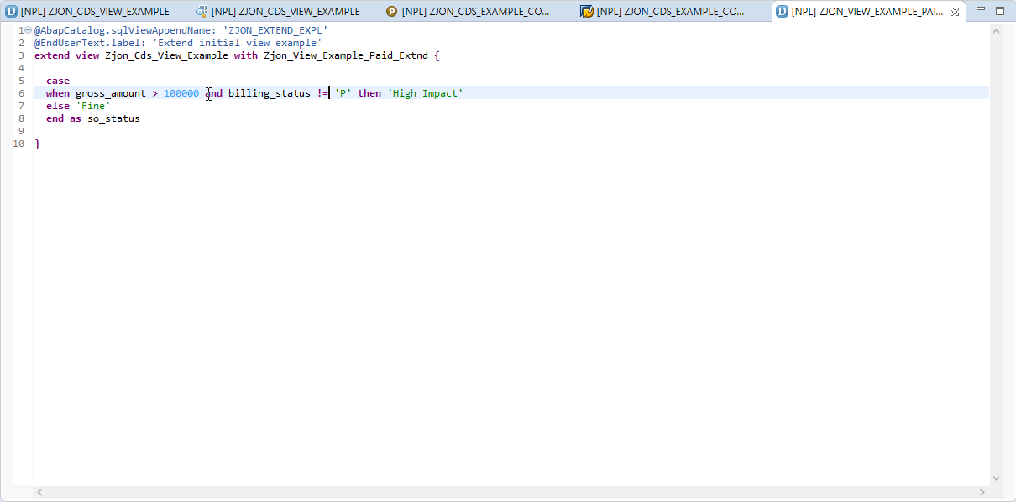
Extending Views
Existing CDS Views can also be “enhanced” by creating a separate Extend View that contains additional fields you would like to include.
For instance, in this example we would like to extend our original view ZJON_CDS_VIEW_EXAMPLE.
To do this we create a NEW view ZJON_VIEW_EXAMPLE_PAID_EXTND as shown to the right.
This will EXTEND the original view and add the field “so_status”.
This is useful when trying to modify views original created by SAP with customs fields.

Slide 25
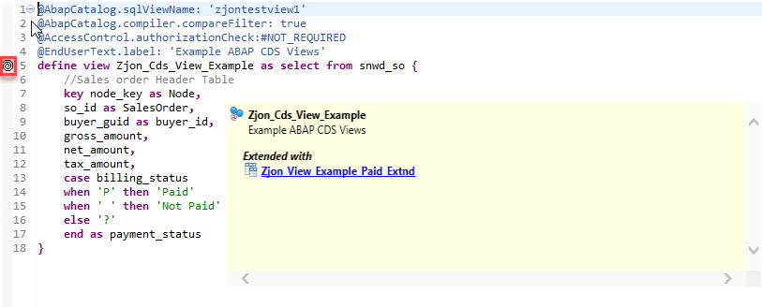
Extending Views
The original views source code will be modified with a familiar icon, which indicates it has been extended by another view

Slide 26
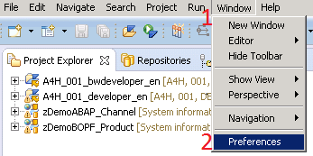
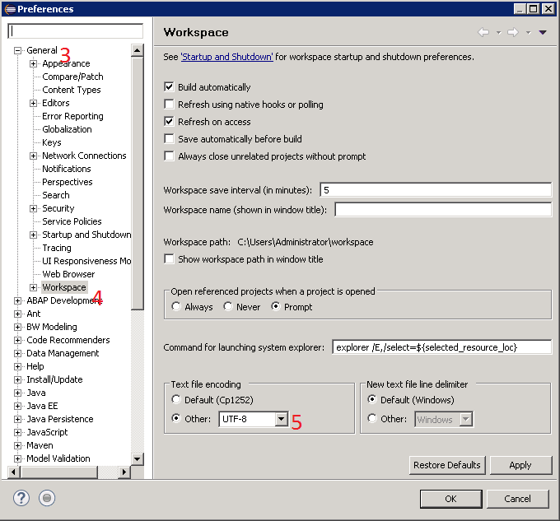
Creating a HANA CDS View (Prerequisite)
If you try to create a HANA CDS View with the default settings, you will get a strange encoding error. Update your workspace settings BEFORE creating your HANA CDS View (or you will have to delete it and restart)
Follow the menu path:
Window->Preferences->General
With the general section expanded, click on the Workspaces text.
Change your encoding from the default cp1252 to UTF-8 (under other)

Slide 27
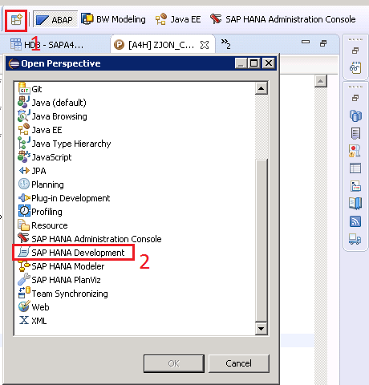
Creating a HANA CDS View
Click the New Perspective icon in the top right of the window (to the left of the ABAP icon)
Locate the SAP HANA Development perspective and hit OK.

Slide 28
Creating a HANA CDS View
2 – Click the “Systems” Tab
3- Double click the HDB system
4 – Enter your password (same as password for everything else)
1- Ensure you are in the SAP HANA Development Perspective(it looks very similar to the ABAP Perspective)

Slide 29
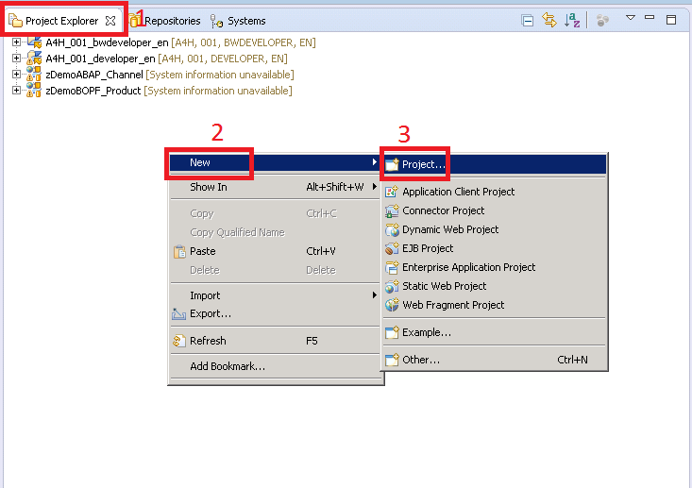
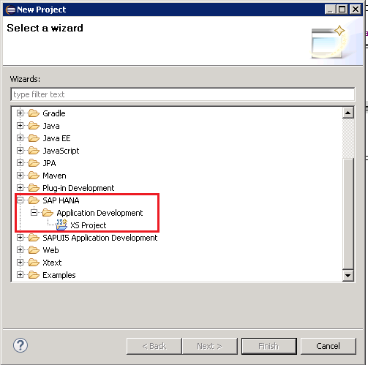
Creating a HANA CDS View
While still in the SAP HANA Development Perspective, navigate to the Project Explorer tab (you will still see your ABAP projects listed, which is fine)
Right click in the white space, then navigate to New->Project…
Follow the menu path SAP HANA->Application Development then click XS Project
Give the project a name (for the source code to work as provided the name must be ZJON_CDS )
Select the Default workspace
Deselect the to access objects and hit finish.

Slide 30
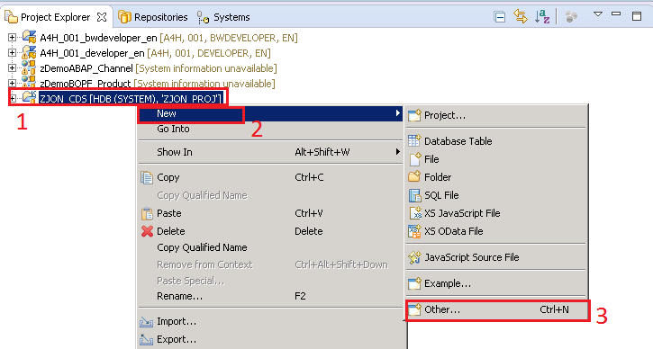
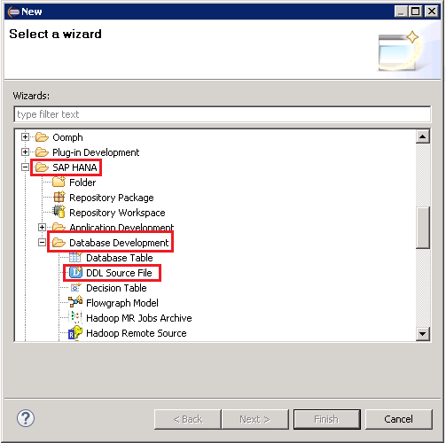
Creating a HANA CDS View
Right click on the new project, the navigate to New->Other
Then navigate to SAP HANA->Database Development-> DDL Source File

Slide 31
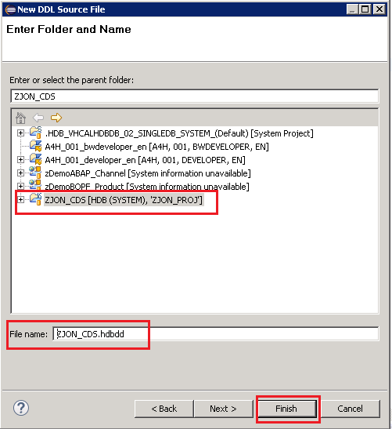
Creating a HANA CDS View
Enter the desired name of your CDS View (it must be ZJON_CDS for the source code to work)
Select the project that was just created
Hit Finish

Slide 32
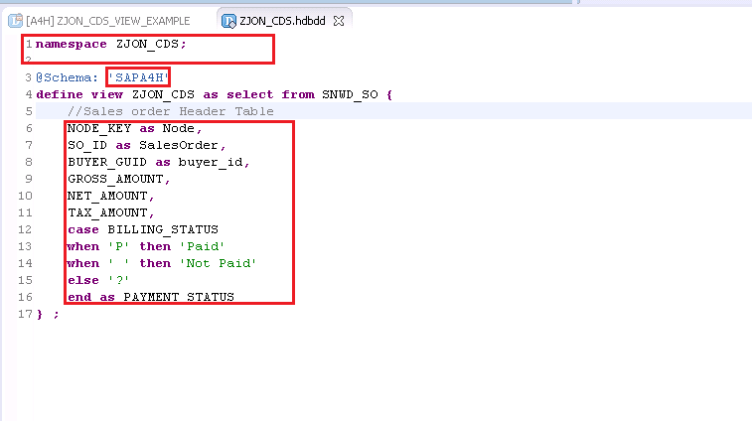
Creating a HANA CDS View
To the right is an example CDS view. You will notice that it does not have the same annotations as the ABAP CDS view.
Instead, it does have the namespace keyword followed by the project name.
In addition, it has an @Schema notation followed by the schema that will be used (this should match the schema that contains your database tables, in this case SAPA4H.
Lastly, note that the field names MUST BE CAPITALIZED (or the code will no compile, leaving you with a very confusing error message)
While this HANA CDS view is still selected, hit the green arrow to activate this CDS view

Slide 33
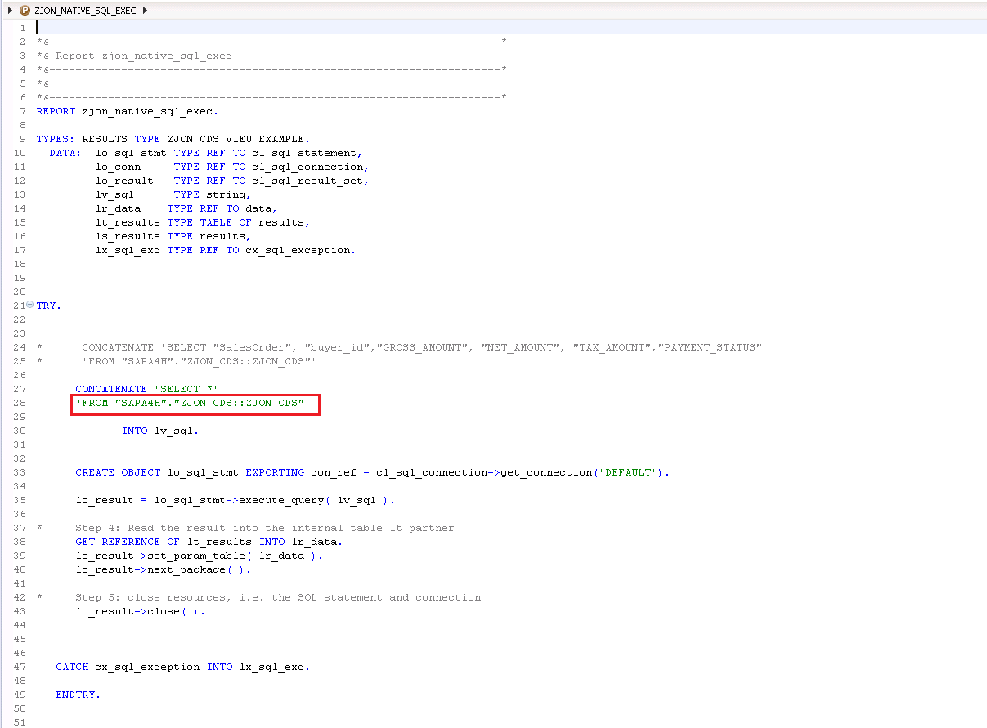
Creating a HANA CDS View
To utilize a HANA CDS View, a Native SQL call is required. This is because the ABAP Data Dictionary has no knowledge of this view since it was defined outside of the NetWeaver AS.
Native SQL can be extremely finicky, and debugging any issues can be extremely difficult.
Compare this code to the first CDS view in terms of complexity, maintainability, and flexibility. Its clear to see why ABAP CDS is always the better option, unless there is some feature that is only accessible through HANA CDS.

